Slide 1
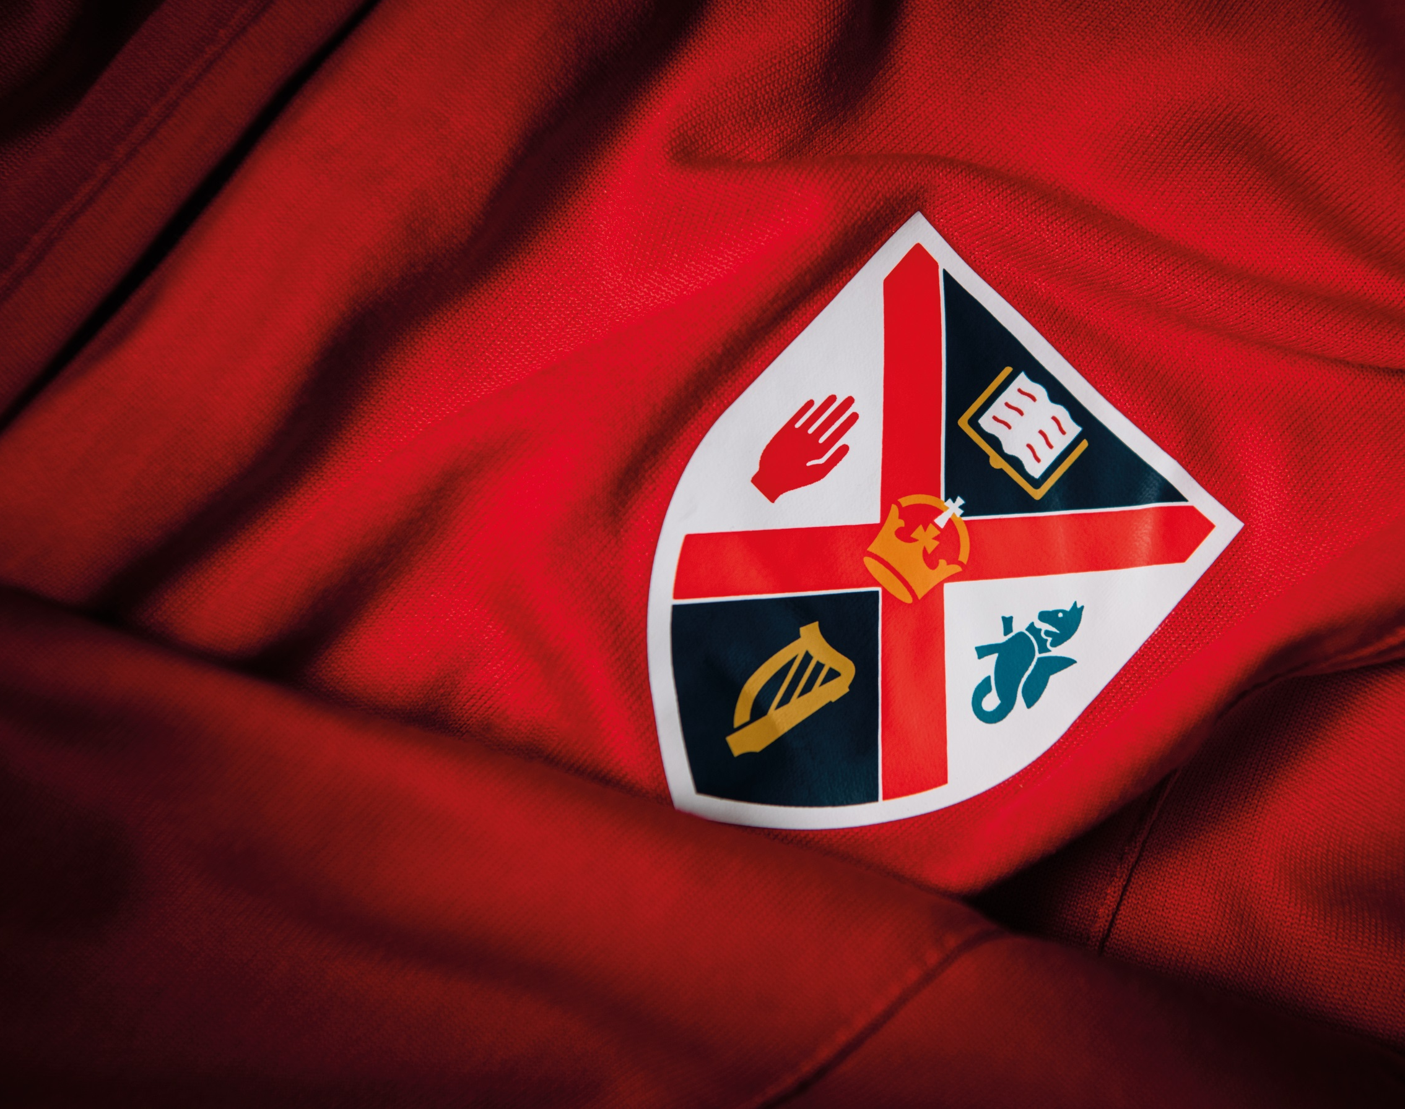
Queens Sport – Degree Plus

Slide 2

Background
The role of sport at Queen’s University can be transformative for students, staff and the wider community and our ambition is to empower well-being and achievement for all through our commitment to the university values.
We are proud of our sporting heritage and of its prominence in the identity of this great institution. Driving a culture of excellence through sport has enabled generations of students to acquire personal and professional skills that have enhanced employability and created an alumni body connected locally and globally that are of the highest calibre.

Slide 3
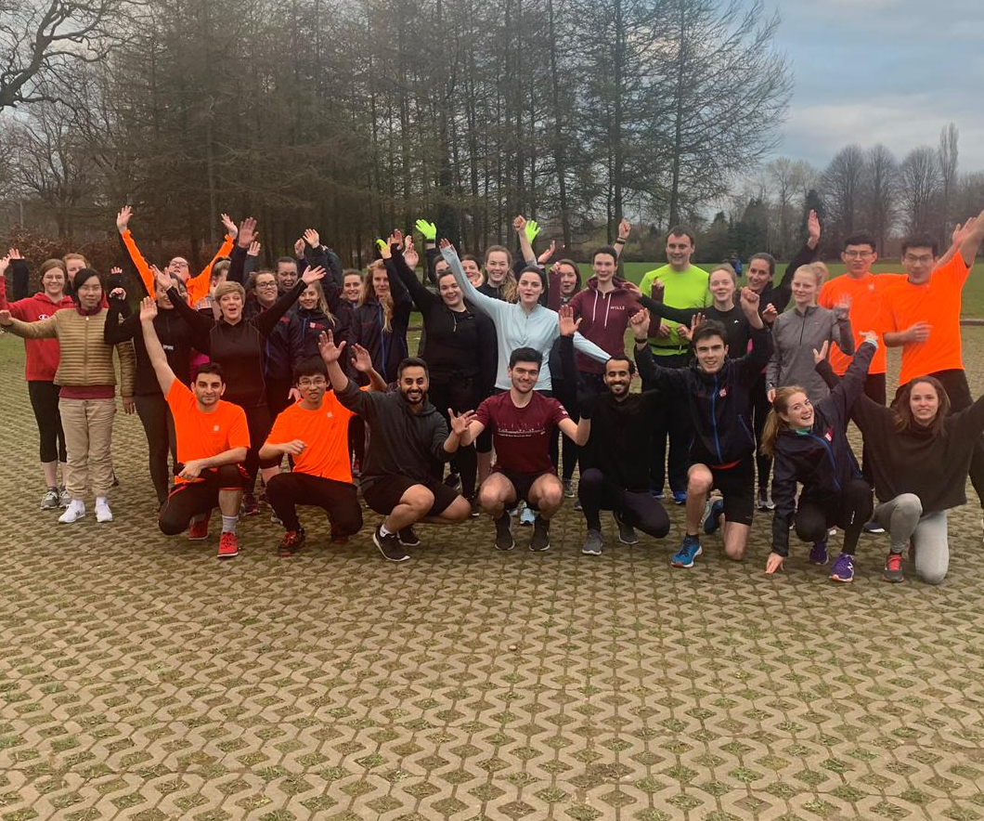
Participation
Active Campus Programme
Social Media
Assisting with the Programmes
Large Events – Queen’s 5K Race and Swimathon
Marshalling
Photography
Hospitality
Sports Clubs Committee Roles
Social Media Promotion
Fundraising

Slide 4
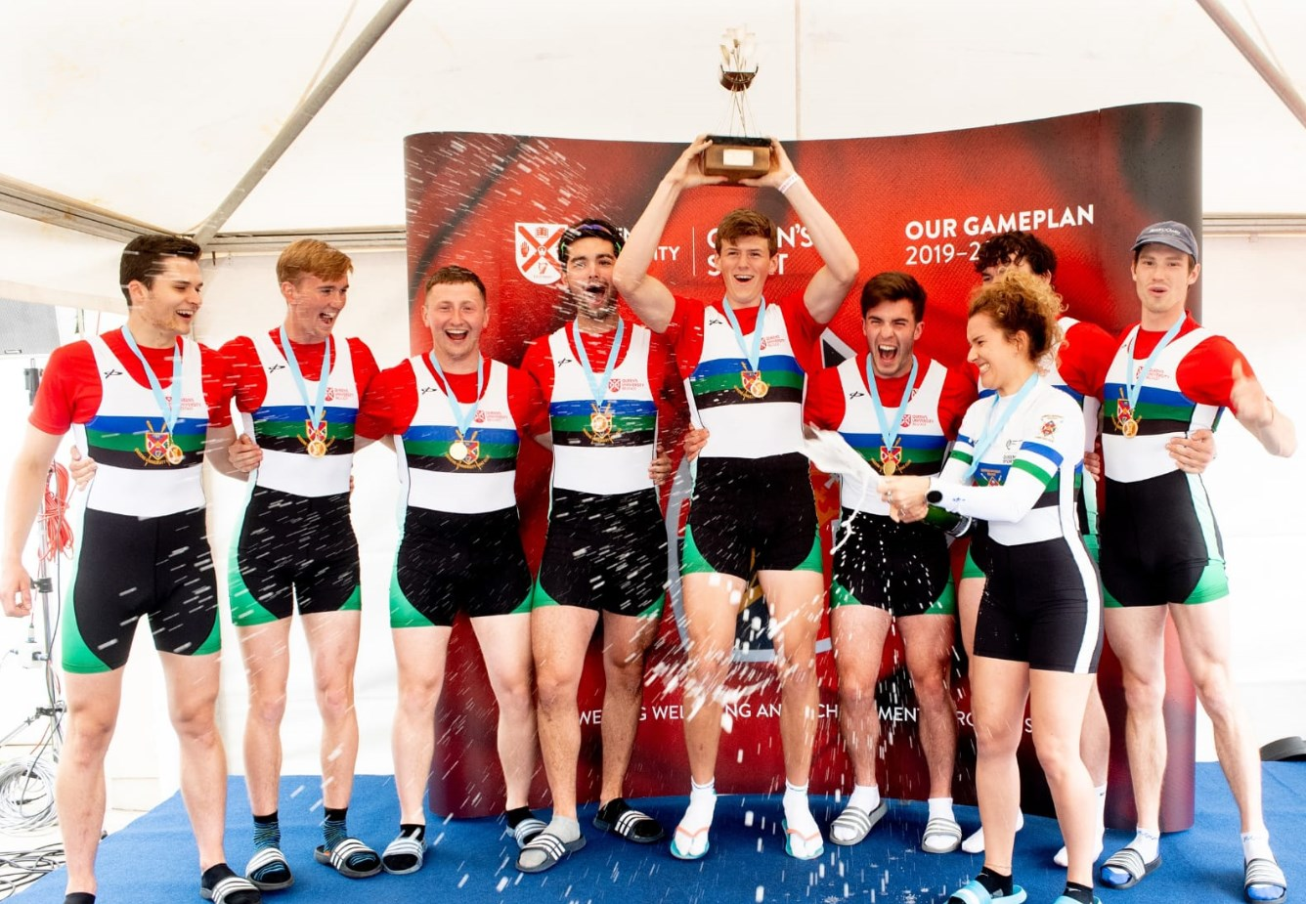
Performance
Match Day Operations
Photography
Ticket Scanning
Elite Athlete Programme
Sports Clubs Committee Roles
Organising competitions
- Coaching

Slide 5
Contact Details
Participation – activecampus@qub.ac.uk
Performance – performancesport@qub.ac.uk
Sports Clubs - https://home.qubsu.org/club-socs/

