Slide 1
Sports Clubs FAQs

Slide 2
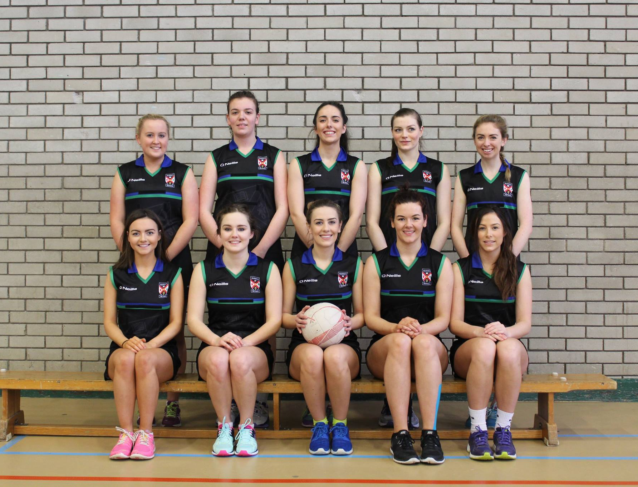
Sports Clubs FAQs
We currently have 52 sports clubs for students to join, most have a wide offering of participation and performance based programmes. To view all of our clubs, visit
https://qubsu.org/ClubsSocieties/

Slide 3
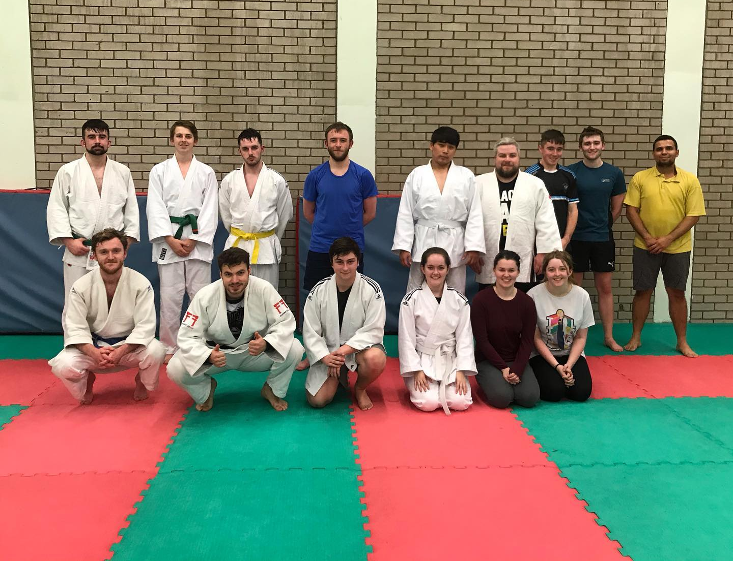
Taster and Trial Sessions
Each club has their own approach to trials and tasters depending on their performance level. Most clubs will offer taster sessions for you to give the sport a go, with progressions to trials if you want to compete in a BUCS or SSI team.
There are alternative options for those who don’t want to compete or didn’t get into a competitive team.
Give it a Try Week from 5th – 11th October all are welcome.

Slide 4
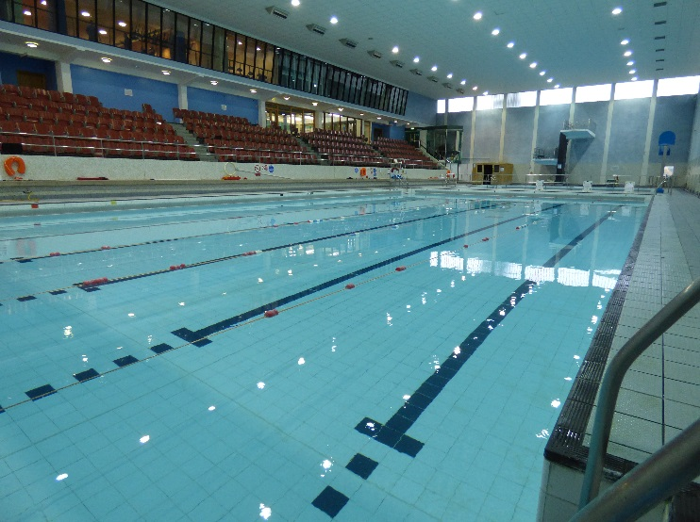
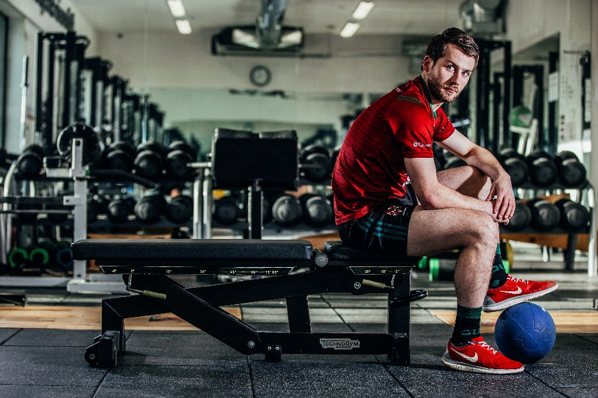
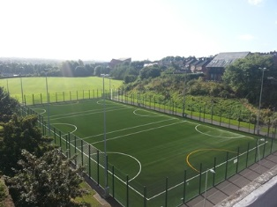
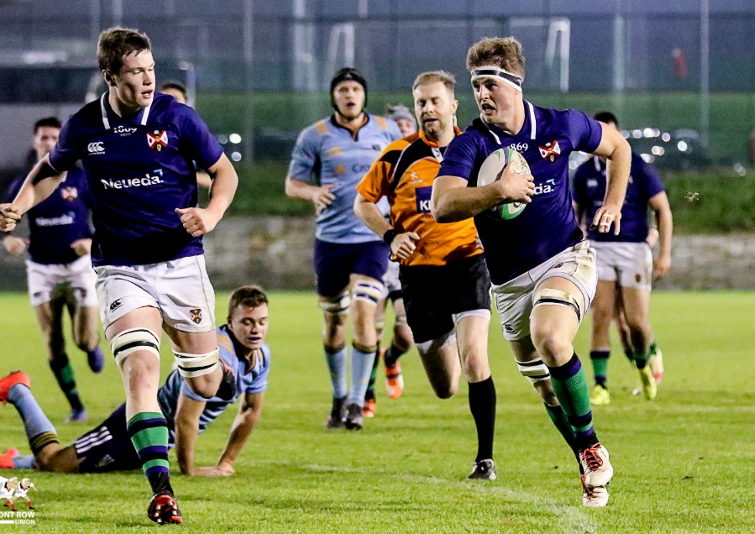
Training Times
Most competitive clubs train 2-5 times a week depending on whether the sport engages with S&C and what level they are competing at. This might be different this year due to Covid restrictions.
Last year’s training times can be found by following this link: http://www.queenssport.com/StudentSport/ClubContacts/
The majority of training takes place between Upper Malone and the PEC unless the sport require specialist equipment or training facilities.

Slide 5
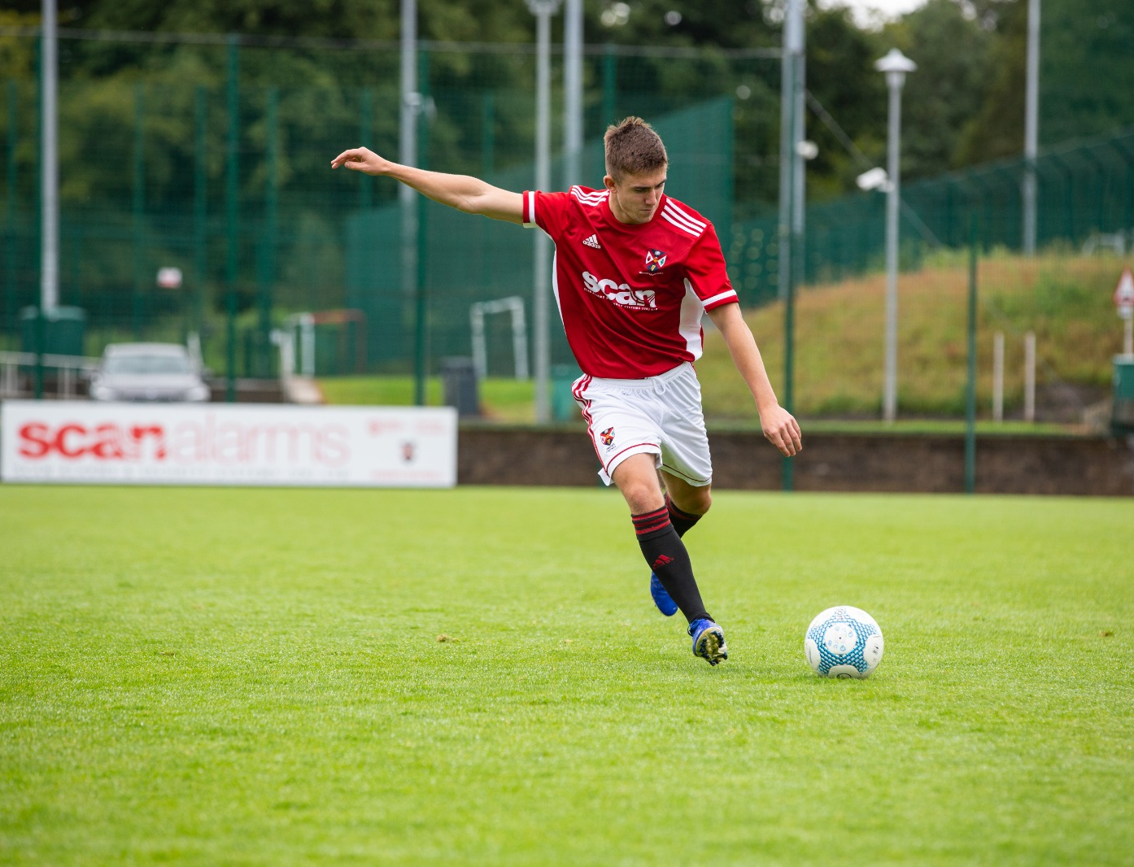
Kit
All our clubs are mandated to compete branded kit, this is available to most when they join a club and are assigned a team. In some clubs the cost of kit will be included in membership, however there will be options to purchase additional leisure wear items if you wish.

Slide 6
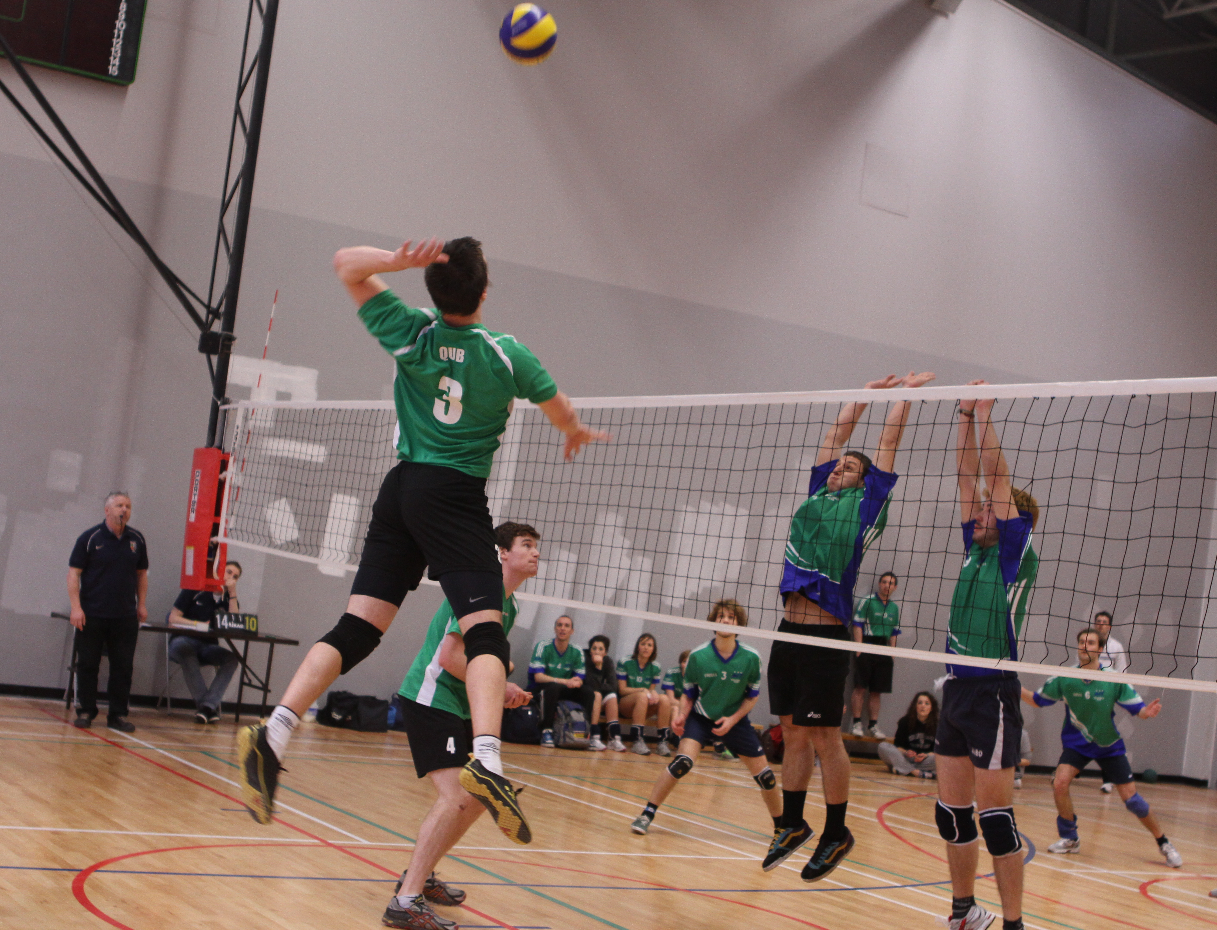
Coaching
All 52 of our clubs have coaches either full time, part time or voluntary coaching from a member of the club.
There are opportunities to gain new skills in coaching through our Active Clubs and attain ‘Degree Plus’ qaulification
https://www.qub.ac.uk/directorates/degreeplus/

Slide 7
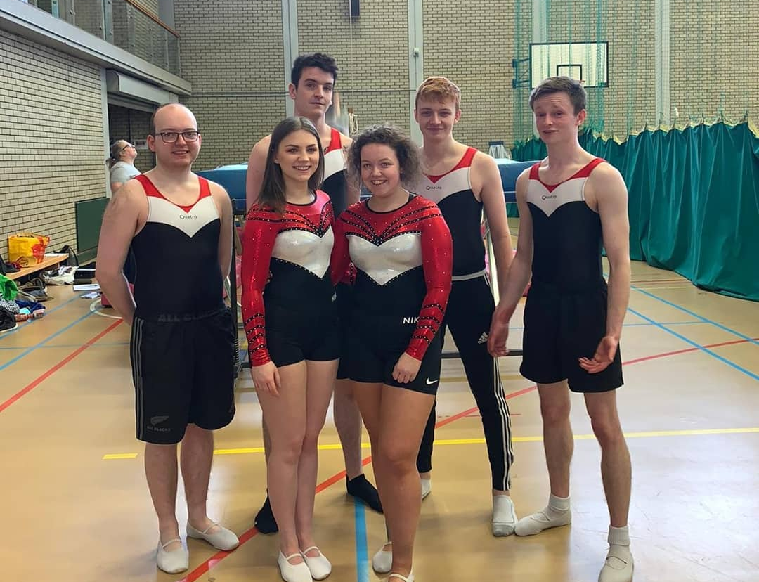
Cost
To join a QUB Sport Club you must purchase the club membership (each club sets their own price) and in most cases the Queen’s Sport membership.
Additional costs may include trips, tours and competition subsidy.

Slide 8
Sports Team Covid Questions

Slide 9
Booking Training Facilities.
Complete & submit your Covid-19 Risk Assessment form to Clubs@qub.ac.uk​
Complete a PEC or Upper Malone bookings form (if applicable) with signed declaration.
Provide guidance from your NGB - where applicable – on the sports safe return.​

Slide 10
Protocols for shared equipment.
Clubs need to make sure that all equipment is sanitised and following their NGB guidelines over shared equipment. Try and make sure if there is shared equipment that the same members get the same equipment as much as possible.

Slide 11
Restrictions in Training Facilities
Area | Room Capacity
Main Hall | 35 People
Minor Hall | Courts 1-4 40 People Overall
Studio 1 | 9 People + Coach
Studio 2 | 7 People + Coach
Studio 3 | 10 People + Coach
Studio 4 | 12 People + Coach
Snack Bar | 4 People + Coach
Outdoor Training Facilities | 66 People
Squash Courts | 5 People Per Court
Strength and Conditioning | 20 People
Functional Room | 10 People
Due to Covid restrictions there is reduced numbers in training facilities.
Each club must follow both their NGB guidelines and the Queens Sport room Capacities.

Slide 12
How will we cater for away teams and changing facilities during this time?​
Changing rooms are closed at present and we will need to take advice from the Central Covid University Safety Group and NGB's as the situation develops.

